Slide 1
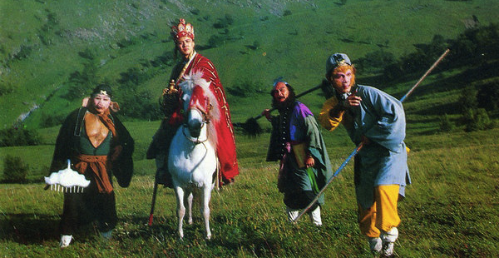
How to Get There? 怎么去？
Lesson 4: Elaboration

Slide 2
Scenario
Tang Seng and his four disciples, Sun Wukong ‘Monkey’, Zhu Bajie ‘Pigsy’, Sha Seng ‘Friar Sand’ and Bai Longma ‘White Dragon Horse’, time travelled to modern China. Unlike the legendary pilgrimage of going through many trials and much suffering to travel to the Xitian ‘Western Regions’ to obtain Buddhist sacred texts, they have to travel to the Xitian University as a group in order to complete their respective professional goals. In this life, Tang Seng is still a professor with the other four as his students. Since his students have different personalities, they have distinctive preferences for transportation means.

Slide 3
Your tasks
Work in groups and perform the skit your group has come up with about how to travel from Beijing (where they are now) to India (where Xitian University locates). Make sure to act out your role according to personal traits of the character.
After watching other groups’ performances, make comparisons and defend your suggestions with simple reasons.

Slide 4
Did you consider the following factors?

Slide 5
Did you consider the following factors?

Slide 6
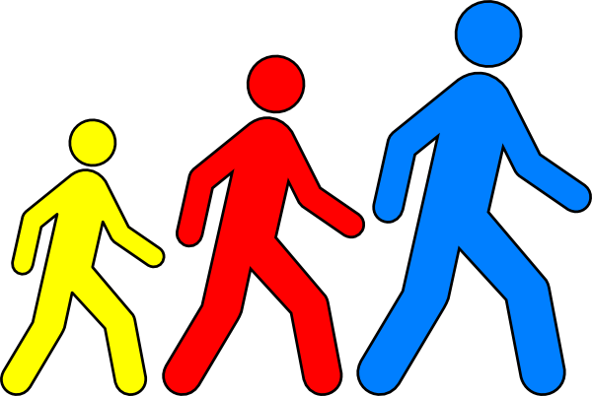
Did you consider the following factors?
对比：好的地方， 不好的地方 | 又 | 又
快
慢
走路
好 玩儿
不shūfu
坐飞机
Shūfu
Lèi
坐船
学 知识
有fēng
坐高铁
骑马
长 见识
Yuǎn

Slide 7
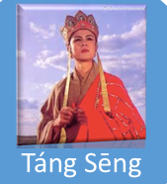
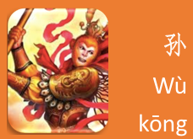
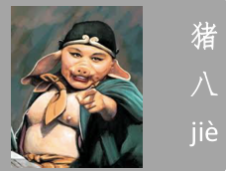
Did you consider the following factors?
人物 | 可能的想法 | 为什么？
走路
坐飞机
坐船
坐高铁
骑马

Slide 8
Comparison & Contrast
人物 | 我们组的想法 | 别的组的想法

